Slide 1
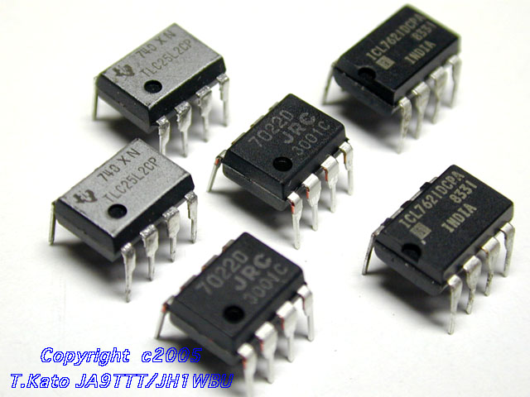
Operational Amplifiers
Notes:
Op-Amps
Lecture 9

Slide 2
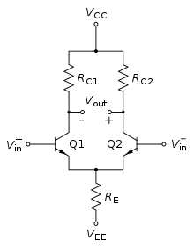
What is Differential Amplifier ?
Differential Amplifier is a type of Electronic amplifier that amplifies the difference between two input voltages but suppresses any voltage common to the two inputs. It is an analog circuits with two inputs V_{in}⁻ & V_{in}⁺ and one output V_{out} , in which the output is ideally proportional to the difference between the two voltages :

Slide 3
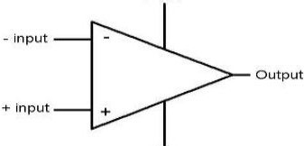
What is OP-amp ?
  An operational amplifier (op-amp) is a DC-coupled high-gain electronic voltage amplifier
  Direct- coupled high gain amplifier usually consisting of one or more differential amplifiers
+ Vss
-Vss
Op-amps are differential amplifiers, and their output voltage is proportional to the difference of the two input voltages.
The two input terminals, called the inverting and non-inverting, are labeled with – and + respectively.

Slide 4
The ideal op-amp
Infinite voltage gain
  a voltage difference at the two inputs is magnified infinitely
  in truth, something like 200,000
  means difference between +ve terminal and −ve terminal is amplified by 200,000.
Infinite input impedance
  no current flows into inputs
  in truth, about 10¹² Ω for FET input op-amps
Zero output impedance
  rock-solid independent of load
  roughly true up to current maximum (usually 5–25 mA)
Infinitely fast (infinite bandwidth)
  in truth, limited to few MHz range
  slew rate limited to 0.5–20 V/μs
Notes:
Op-Amps
Lecture 9

Slide 5
Op-amp without feedback
The internal op-amp formula is:
  V_{out} = gain×(V₊ − V₋)
So if V₊ is greater than V₋, the output goes positive
If V₋ is greater than V₊, the output goes negative
A gain of 200,000 makes this device (as illustrated here) practically useless
V₋
−
V_{out}
V₊
+
Notes:
Op-Amps
Lecture 9

Slide 6
Infinite Gain in negative feedback
Infinite gain would be useless except in the self-regulated negative feedback regime
  negative feedback seems bad, and positive good.
  but in electronics positive feedback means runaway or oscillation, and negative feedback leads to stability
Imagine hooking the output to the inverting terminal:
If the output is less than V_{in}, it shoots positive
If the output is greater than V_{in}, it shoots negative
  result is that output quickly forces itself to be exactly V_{in}
−
negative feedback loop
V_{in}
+
Notes:
Op-Amps
Lecture 9

Slide 7
Op-Amp “Golden Rules”
When an op-amp is configured in any negative-feedback arrangement, it will obey the following two rules:
  The inputs to the op-amp draw or source no current (true whether negative feedback or not)
  The op-amp output will do whatever it can (within its limitations) to make the voltage difference between the two inputs zero
Notes:
Op-Amps
Lecture 9

Slide 8
Inverting amplifier example
R₂
R₁
V_{in}
−
V_{out}
+
Applying the rules: +ve terminal at “virtual ground”
  so current through R₁ is I_{f} = V_{in}/R₁
Current does not flow into op-amp (as infinite input impedance is there)
  so the current through R₁ must go through R₂
  voltage drop across R₂ is then I_{f}R₂ = V_{in}×(R₂/R₁)
So V_{out} = 0 − V_{in}×(R₂/R₁) = −V_{in}×(R₂/R₁)
Thus we amplify V_{in} by factor −R₂/R₁
  negative sign earns title “inverting” amplifier
Current is drawn into op-amp output terminal
Notes:
Op-Amps
Lecture 9

Slide 9
Non-inverting Amplifier
R₂
R₁
−
V_{out}
V_{in}
+
Now +ve terminal held at V_{in}
  so current through R₁ is I_{f} = V_{in}/R₁ (to left, into ground)
This current cannot come from op-amp input
  so comes through R₂ (delivered from op-amp output)
  voltage drop across R₂ is I_{f}R₂ = V_{in}×(R₂/R₁)
  so that output is higher than neg. input terminal by V_{in}×(R₂/R₁)
  V_{out} = V_{in} + V_{in}×(R₂/R₁) = V_{in}×(1 + R₂/R₁)
  thus gain is (1 + R₂/R₁), and is positive
Current is sourced from op-amp output in this example
Notes:
Op-Amps
Lecture 9

Slide 10
Summing Amplifier
R_{f}
R₁
V₁
−
R₂
V_{out}
V₂
+
Much like the inverting amplifier, but with two input voltages
  inverting input still held at virtual ground
  I₁ and I₂ are added together to run through R_{f}
  so we get the (inverted) sum: V_{out} = −R_{f}×(V₁/R₁ + V₂/R₂)
    if R₂ = R₁, we get a sum proportional to (V₁ + V₂)
We Can have any number of summing inputs
Notes:
Op-Amps
Lecture 9

Slide 11
Subtractor
R₂
R₁
V⁻
−
V_{node}
V_{out}
V⁺
+
R₁
R₂
The non-inverting input is a simple voltage divider:
  V_{node} = V⁺[R₂/(R₁ + R₂)]
So I_{f} = (V⁻ − V_{node})/R₁
  V_{out} = V_{node} − I_{f}R₂ = V⁺(1 + R₂/R₁)(R₂/(R₁ + R₂)) − V⁻(R₂/R₁)
  so V_{out} = (R₂/R₁)(V⁺ − V⁻)
  therefore we difference V⁺ and V⁻
Notes:
Op-Amps
Lecture 9

Slide 12
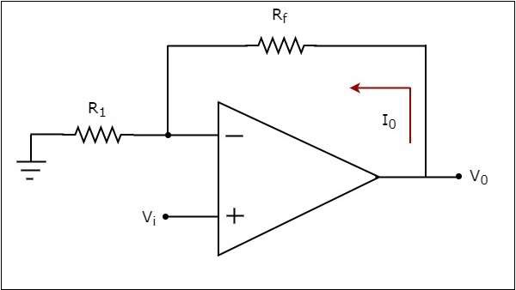
Voltage to Current Converters
A voltage to current converter or V to I converter, is an electronic circuit that takes current as the input and produces voltage as the output.
An input voltage V_{i} is applied at the non-inverting input terminal of the op-amp. According to the virtual short concept, the voltage at the inverting input terminal of an op-amp will be equal to the voltage at its non-inverting input terminal. So, the voltage at the inverting input terminal of op-amp will be V_{i}
The nodal equation at the inverting input terminal's node is −
V_{i} / R₁ – I_{o} = 0
I_{o}=V_{t} / R₁
Thus output current I_{o} of a V to I converter is the ratio of its input voltage V_{i} and resistance R₁ .
I_{o}/V_{t} = R₁

Slide 13
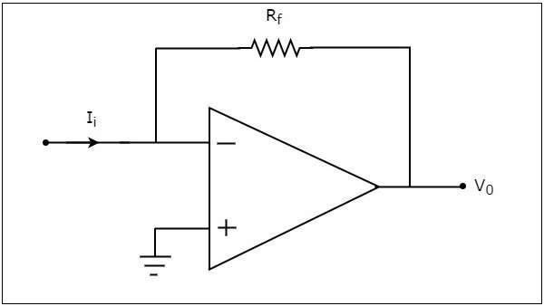
Current to Voltage Converters
An op-amp based current to voltage converter produces an output voltage when current is applied to its inverting terminal.
In the circuit shown above, the non-inverting input terminal of the op-amp is connected to ground. That means zero volts is applied at its non-inverting input terminal.
According to the virtual short concept, the voltage at the inverting input terminal of an op-amp will be equal to the voltage at its non-inverting input terminal. So, the voltage at the inverting input terminal of the op-amp will be zero volts.
The nodal equation at the inverting terminal's node is −
−I_{i}+(0−V₀)/R_{f}=0
−I_{i}=V₀/R_{f}
V₀=−R_{t}/I_{i}

Slide 14
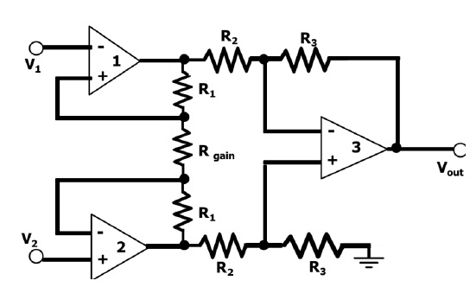
Instrumentation Amplifier
An instrumentation amplifier is used to amplify very low-level signals, rejecting noise and interference signals. Examples can be heartbeats, blood pressure, temperature, earthquakes and so on.
The op-amps 1 & 2 are non-inverting amplifiers and op-amp 3 is a difference amplifier. These three op-amps together, form an instrumentation amplifier. Instrumentation amplifier’s final output Vout is the amplified difference of the input signals applied to the input terminals of op-amp 3.Let the outputs of op-amp 1 and op-amp 2 be Vo1 and Vo2 respectively.

Slide 15
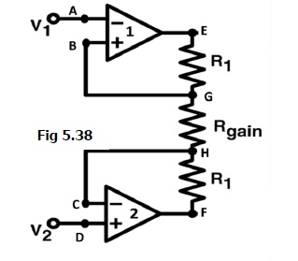
The potential at node A is the input voltage V1. Hence the potential at node B is also V1, from the virtual short concept. Thus, the potential at node G is also V1.
The potential at node D is the input voltage V2. Hence the potential at node C is also V2, from the virtual short. Thus, the potential at node H is also V2.
The working of the instrumentation amplifier is, Ideally the current to the input stage op-amps is zero. Therefore the current I through the resistors R1, Rgain, and R1 remain the same.
Applying Ohm’s law between nodes E and F,
I=(Vo1-Vo2)/(R1+Rgain+R1) ….(1)
I = (Vo1-Vo2)/(2R1+Rgain)

Slide 16
Since no current is flowing to the input of the op-amps 1 & 2, the current I between the nodes G and H can be given as,
I = (VG-VH) / Rgain = (V1-V2) / Rgain……………………….(2)
Equating equations 1 and 2,
(Vo1-Vo2)/(2R1+Rgain) = (V1-V2)/Rgain
(Vo1-Vo2) =(2R1+Rgain)(V1V2)/Rgain ………… (3)
The output of the difference amplifier is given as,
Vout = (R3/R2) (Vo1-Vo2)
Therefore, (Vo1 – Vo2) = (R2/R3)Vout
Substituting (Vo1 – Vo2) value in equation 3, we get
(R2/R3)Vout = (2R1+Rgain)(V1-V2)/Rgain
i.e. Vout = (R3/R2){(2R1+Rgain)/Rgain}(V1-V2)
This above equation gives the output voltage of an instrumentation amplifier.

Slide 17
The overall gain of the amplifier is given by the term (R3/R2){(2R1+Rgain)/Rgain}.
The overall voltage gain of an instrumentation amplifier can be controlled by adjusting the value of resistor Rgain.
The common mode signal attenuation for the instrumentation amplifier is provided by the difference amplifier.

Slide 18
Comparator
A comparator is an electronic circuit, which compares the two inputs that are applied to it and produces an output. The output value of the comparator indicates which of the inputs is greater or lesser.
An op-amp consists of two input terminals and hence an op-amp based comparator compares the two inputs that are applied to it and produces the result of comparison as the output.
Comparators are of two types :
Inverting
Non-inverting.

Slide 19
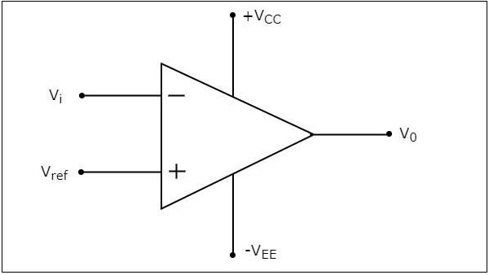
Inverting Comparator :
An inverting comparator is an op-amp based comparator for which a reference voltage is applied to its non-inverting terminal and the input voltage is applied to its inverting terminal. This comparator is called as inverting comparator because the input voltage, which has to be compared is applied to the inverting terminal of op-amp.
It produces one of the two values ₊V_{sat} and ₋V_{sat} at the output based on the values of its input voltage V_{i} and the reference voltage V_{ref}
The output value of an inverting comparator will be ₋V_{sat} for which
the input V_{i} voltage is greater than the reference voltage V_{ref}
The output value of an inverting
Comparator will be ₊V_{sat} ,for which
The input V_{i} voltage is less than
the reference voltage V_{ref}

Slide 20
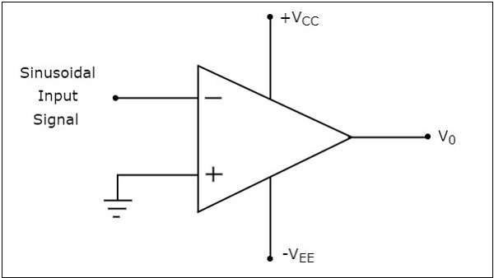
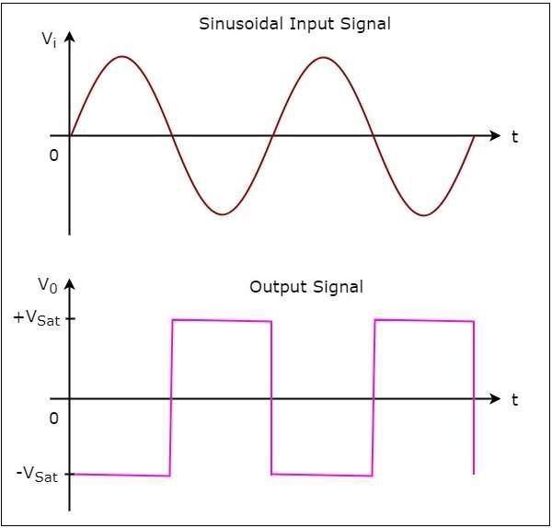
Let us draw the output wave form of an inverting comparator, when a sinusoidal input signal and a reference voltage of zero volts are applied to its inverting and non-inverting terminals respectively.
During the positive half cycle of the sinusoidal input signal, the voltage present at the inverting terminal of op-amp is greater than zero volts. Hence, the output value of the inverting comparator will be equal to ₋V_{sat} during positive half cycle of the sinusoidal input signal.
Similarly, during the negative half cycle of the sinusoidal input signal, the voltage present at the inverting terminal of the op-amp is less than zero volts. Hence, the output value of the inverting comparator will be equal to ₊V_{sat} during negative half cycle of the sinusoidal input signal.

Slide 21
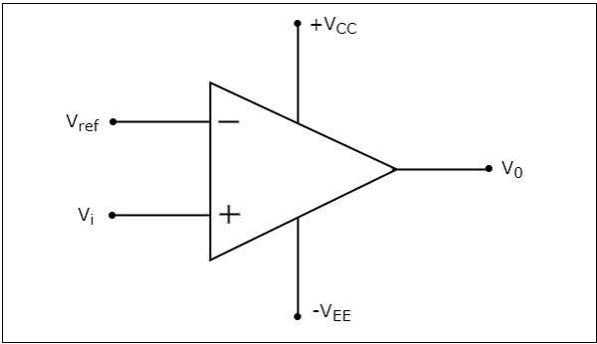
Non-Inverting Comparator :
A non-inverting comparator is an op-amp based comparator for which a reference voltage is applied to its inverting terminal and the input voltage is applied to its non-inverting terminal. This op-amp based comparator is called as non-inverting comparator because the input voltage, which has to be compared is applied to the non-inverting terminal of the op-amp.
It produces one of the two values, ₊V_{sat} and ₋V_{sat} at the output based on the values of input voltage V_{i} and the reference voltage ₊V_{ref}
The output value of a non-inverting comparator will be ₊V_{sat} for which the input voltage V_{i} is greater than the reference voltage ₊V_{ref} .
The output value of a non-inverting
comparator will be ₋V_{sat} for which the
input voltage V_{i} is less than
the reference voltage ₊V_{ref} .

Slide 22
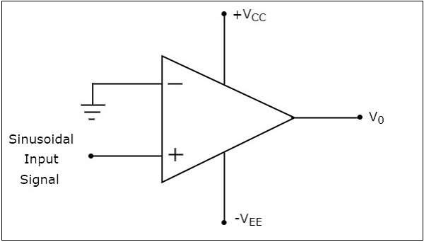
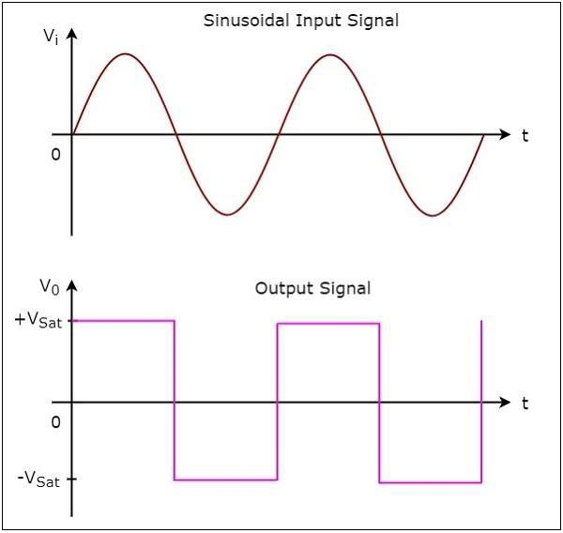
Let us draw the output wave form of a non-inverting comparator, when a sinusoidal input signal and reference voltage of zero volts are applied to the non-inverting and inverting terminals of the op-amp respectively.
During the positive half cycle of the sinusoidal input signal, the voltage present at the non-inverting terminal of op-amp is greater than zero volts. Hence, the output value of a non-inverting comparator will be equal to ₊V_{sat} during the positive half cycle of the sinusoidal input signal.
Similarly, during the negative half cycle of the sinusoidal input signal, the voltage present at the non-inverting terminal of op-amp is less than zero volts. Hence, the output value of non-inverting comparator will be equal to ₋V_{sat} during the negative half cycle of the sinusoidal input signal.

Slide 23
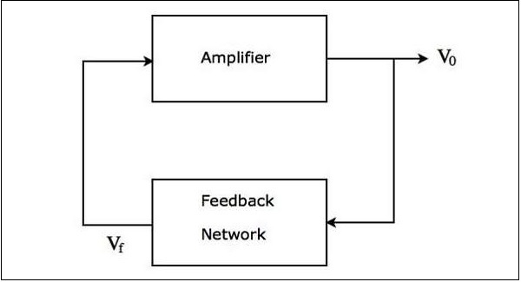
Oscillators :
An oscillator is an electronic circuit that produces a periodic signal. If the oscillator produces sinusoidal oscillations, it is called as a sinusoidal oscillator. It converts the input energy from a DC source into an AC output energy of a periodic signal. This periodic signal will be having a specific frequency and amplitude.
The block diagram of a sinusoidal oscillator
Multivibrators :
The Op-amp Multivibrator is an astable oscillator circuit that generates a rectangular output waveform using an RC timing network connected to the inverting input of the operational amplifier and a voltage divider network connected to the other non-inverting input.

Slide 24
Differentiator (high-pass)
R
C
V_{in}
−
V_{out}
+
For a capacitor, Q = CV, so I_{cap} = dQ/dt = C·dV/dt
  Thus V_{out} = −I_{cap}R = −RC·dV/dt
So we have a differentiator, or high-pass filter
  if signal is V₀sinωt, V_{out} = −V₀RCωcosωt
  the ω-dependence means higher frequencies amplified more
Notes:
Op-Amps
Lecture 9

Slide 25

Low-pass filter (integrator)
C
R
V_{in}
−
V_{out}
+
I_{f} = V_{in}/R, so C·dV_{cap}/dt = V_{in}/R
  and since left side of capacitor is at virtual ground:
  −dV_{out}/dt = V_{in}/RC
  so
  and therefore we have an integrator (low pass)
Notes:
Op-Amps
Lecture 9

